Slide 1

Gokaraju Rangaraju Institute of Engineering and Technology
(Autonomous) Department of Information Technology
A Major Project on
AGRICULTURE YIELD PREDICTION SYSTEM USING MACHINE LEARNING ALGORITHMS
Team Members
(21241A12J7) T.Archana
(21241A12D3) B.Shivani
(21241A12E4) E.Reena
Guide
J. ALEKHYA

Slide 2
Contents
Abstract
Aim and Scope
Existing System
Proposed System
System Specifications
References
Literature Survey
Design
Source Code
Final Output

Slide 3
Abstract
India, as an agrarian nation, relies heavily on agriculture for its economic stability, but the sector faces challenges due to climate change and environmental factors. Machine learning offers a practical solution to these issues, with crop yield prediction playing a vital role. By analyzing historical data such as weather, soil properties, and past crop yields, this project utilizes the Random Forest algorithm, a popular supervised learning method, to predict crop yields. These predictions can help farmers estimate potential yield before cultivation, aiding in better planning and resource management.
The project will also provide crop recommendations based on factors like pH levels, rainfall, and crop type, helping farmers choose high-yield crops suitable for specific conditions. The final outcome will be a web application that not only predicts crop yield but also suggests optimal crops, empowering farmers to maximize productivity and efficiency in their agricultural practices.

Slide 4
Aim
The project aims to develop a system that predicts crop yields and provides crop recommendations using historical data and environmental factors. By analyzing conditions like weather and soil, the system will help farmers make informed decisions. This will enable better resource optimization and improved profitability. A web application will deliver these insights to farmers.
Scope
The project scope includes gathering historical data on weather, soil, and crop yields to predict future yields using the Random Forest algorithm. It will also offer crop recommendations based on environmental factors like pH and rainfall. A web application will deliver these insights, helping farmers optimize resources and increase profitability.

Slide 5
Existing System
The current system predicts crop yield using Logistic Regression, Naïve Bayes, and Random Forest with limited parameters, but lacks a crop recommendation feature.
Multiple Linear Regression is also used for yield prediction based on weather, soil, and management factors, but it does not provide crop recommendations either.
Both models have limited accuracy due to few parameters and no recommendation system.- Improvement Needed: Adding more attributes and a crop recommendation feature can enhance both accuracy and usefulness for farmers.

Slide 6
Proposed System
The proposed system is a web application designed to both predict crop yield and recommend high-yielding crops. This dual functionality aims to assist farmers in making informed decisions for maximizing productivity.
The prediction model takes into account several key factors such as temperature, area, nitrogen content, season, and rainfall to accurately estimate crop yields, ensuring that diverse environmental and soil conditions are considered.
The system utilizes the Random Forest Regressor algorithm, known for its high accuracy in prediction tasks. This machine learning model ensures the best possible predictions of crop yield based on historical and environmental data.

Slide 7
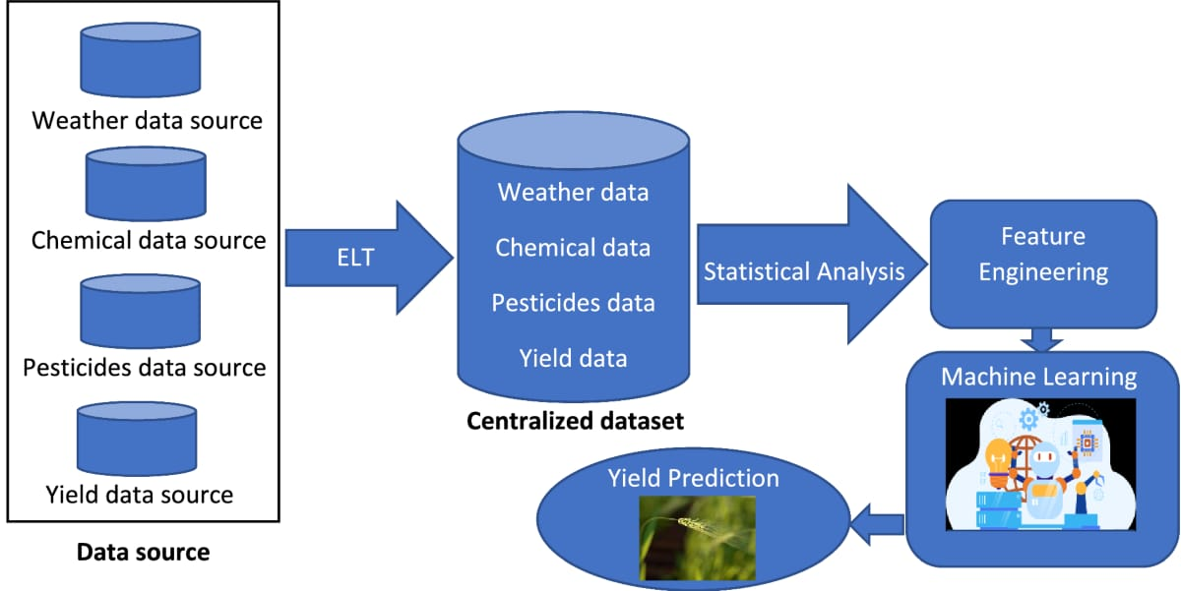
System Architecture

Slide 8
System Specifications
Software
Operating System - Any OS capable of running Python and web browsers (Mac, Windows, Linux).
Front-end - HTML, CSS.
Libraries – pandas, scikit-learn, Numpy, Matplotlib
Languages - Python 3.x.
Tools Required - Jupyter Notebook.

Slide 9
Hardware
Processor –Intel core i3 and above
Memory – 4GB RAM and above
Input devices – Keyboard Mouse
Internet

Slide 10
References
https://www.kaggle.com/opencvmlpython/crop-yield-dataset 2017?select=NewCropTrainFinal.csv
https://ieeexplore.ieee.org/abstract/document/9432236/
https://www.sciencedirect.com/topics/earth-and-planetary-sciences/crop-yield

Slide 11
Literature Survey

Slide 12
Title | Author & Year of Publication | Objectives | Gaps Identified | Methodology | Result
Machine Learning: Applications in Indian Agriculture | Karandeep Kaur, 2016 | Explore machine learning applications to improve agricultural practices. | Limited adoption of modern technologies by farmers | Sensor-based systems and ML algorithms for precision farming. | Potential of ML in addressing challenges and promoting precision farming.
Impacts of population growth, economic development, and technical change on global food production and consumption | Uwe A. Schneider et al., 2011 | Assess food production under scenarios of population growth and technical changes. | Rising food demand with limited resources. | Modeled scenarios using population, land, and water data. | Population growth increases food production; resource limitations raise costs.

Slide 13
Title | Author & Year of Publication | Objectives | Gaps Identified | Methodology | Result
A Review on Data Mining Techniques for Fertilizer Recommendation | Jignasha M. Jethva, Nikhil Gondaliya, Vinita Shah, 2018 | Overview of data mining techniques for precise fertilizer recommendations | Excess or deficient fertilizer use harms yield. | Analysis of data mining frameworks on soil datasets. | Importance of data mining in efficient fertilizer application.
A Survey on Data Mining Techniques in Agriculture | M.C.S. Geetha, 2015 | Study the role of data mining in agriculture for better decision-making. | Lack of consolidated knowledge in agricultural applications. | Literature review of data mining techniques in farming. | Insights into current practices and applications of data mining.

Slide 14
Title | Author & Year of Publication | Objectives | Gaps Identified | Methodology | Result
Machine Learning Facilitated Rice Prediction in Bangladesh | Mohammad Motiur Rahman, Naheena Haq, Rashedur M Rahman, 2015 | Explore the relationship between weather variables and crop yield using machine learning. | Lack of clarity on dependence among weather factors and crop yield. | Used SOM to group data, followed by chi-square tests for dependency. | Extreme weather conditions are key drivers of crop growth and yield.
Support Vector Machine-Based Classification Scheme of Maize Crop | Suhas S Athani, CH Tejeshwar, 2017 | Develop an automated system to classify weeds from crops using image data. | Limited feature extraction techniques for improving classification. | SVM applied to texture features of maize images to classify weed/crop. | Achieved 72% accuracy; scope for further exploration of feature extraction techniques.

Slide 15
Design

Slide 16
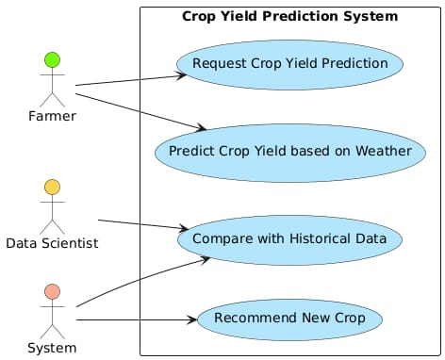
USECASE DIAGRAM

Slide 17
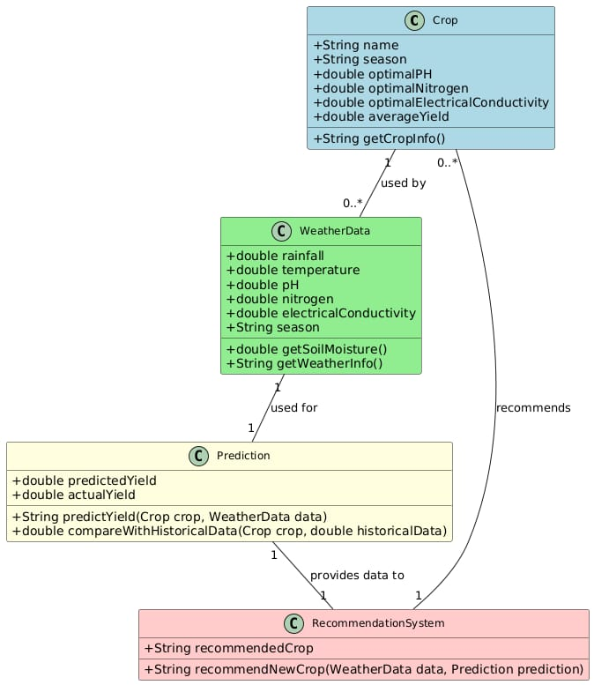
CLASS DIAGRAM

Slide 18
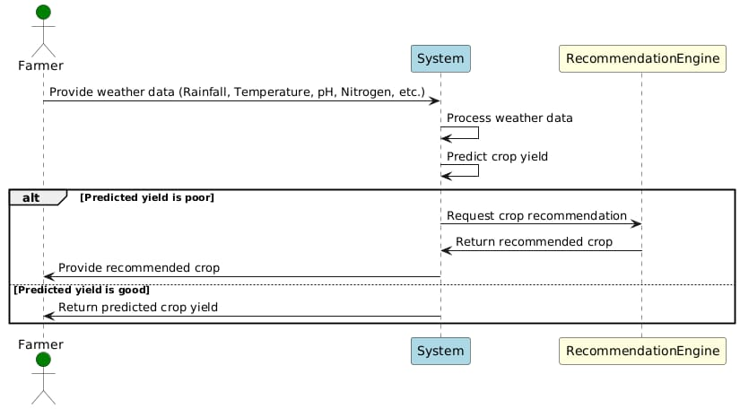
SEQUENCE DIAGRAM

Slide 19
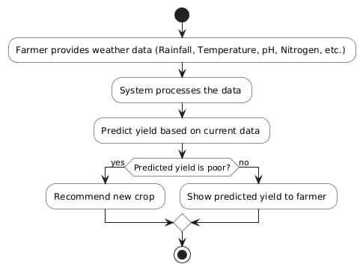
ACTIVITY DIAGRAM

Slide 20
Source Code

Slide 21
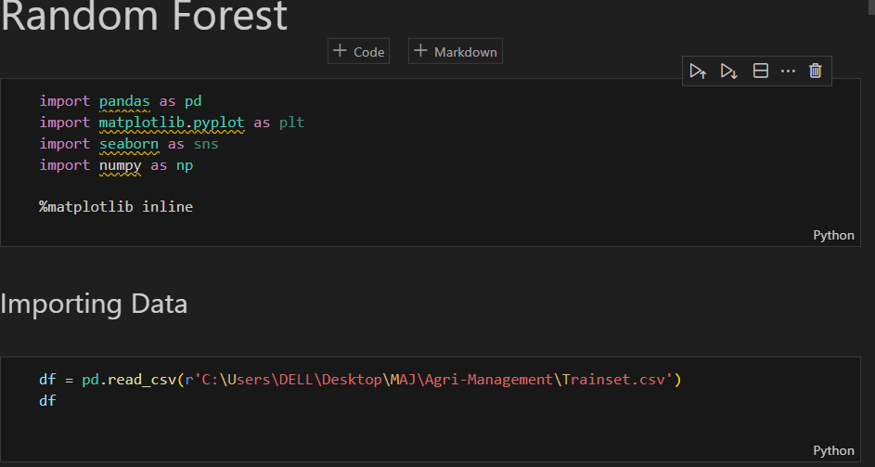
Importing Modules

Slide 22
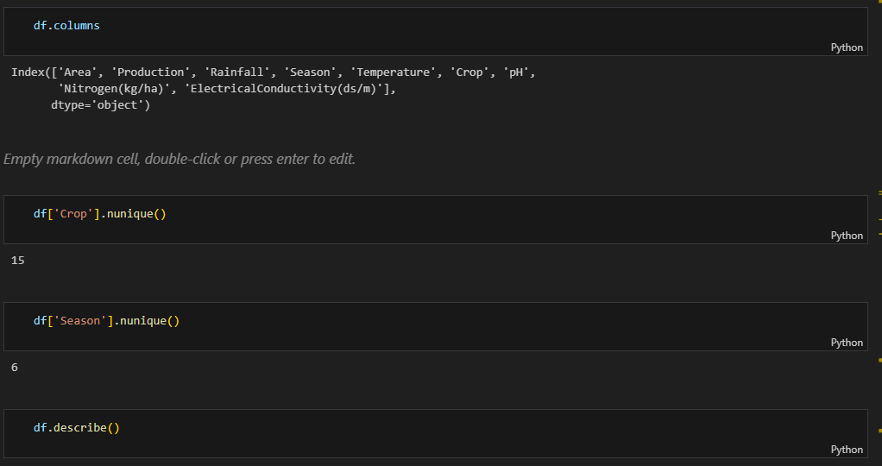
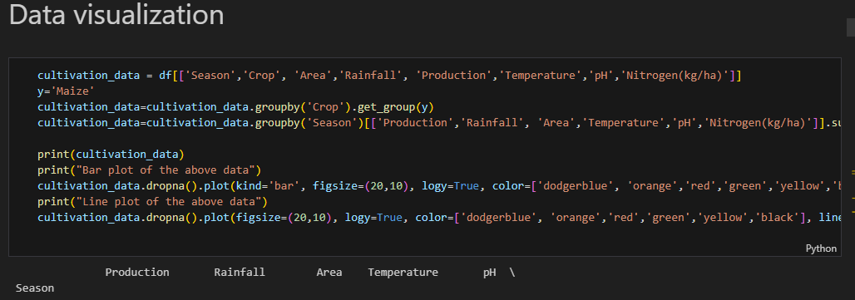
Data Visualization

Slide 23
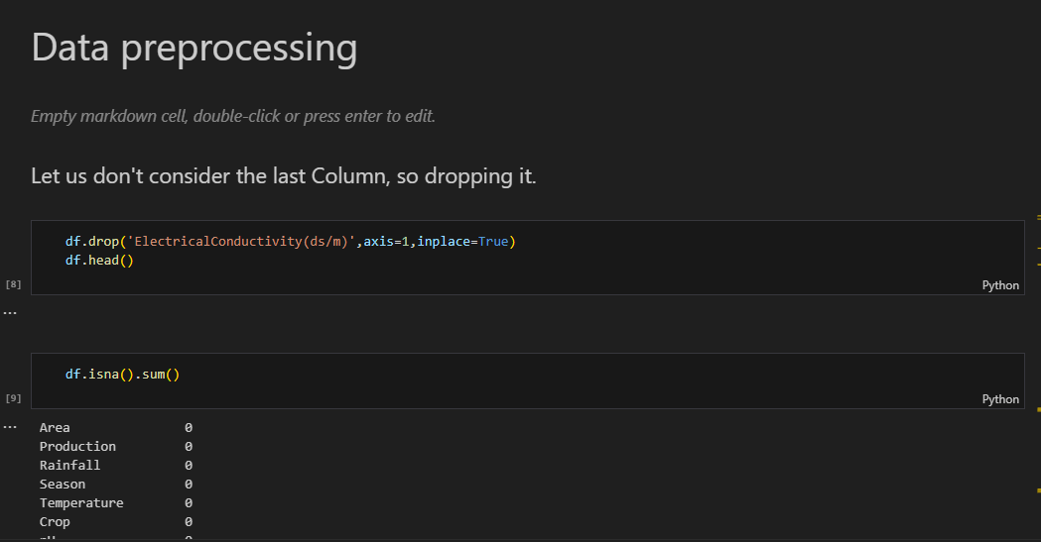
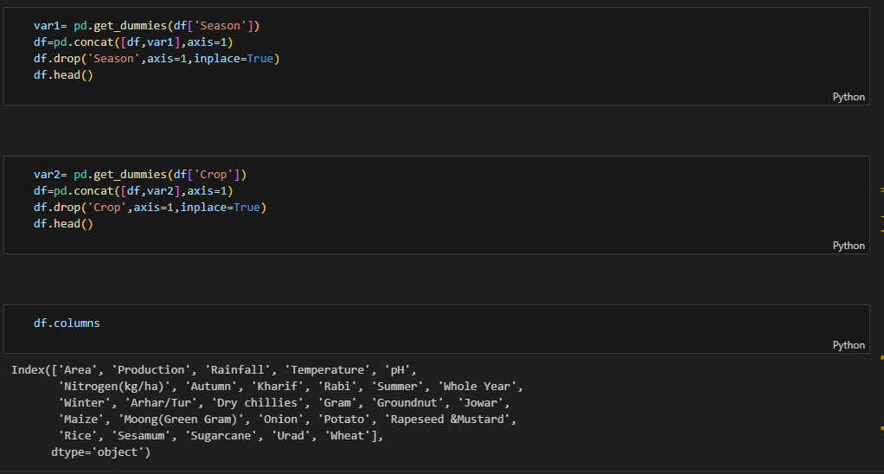
Data Preprocessing
Prepare Dataset Objects

Slide 24
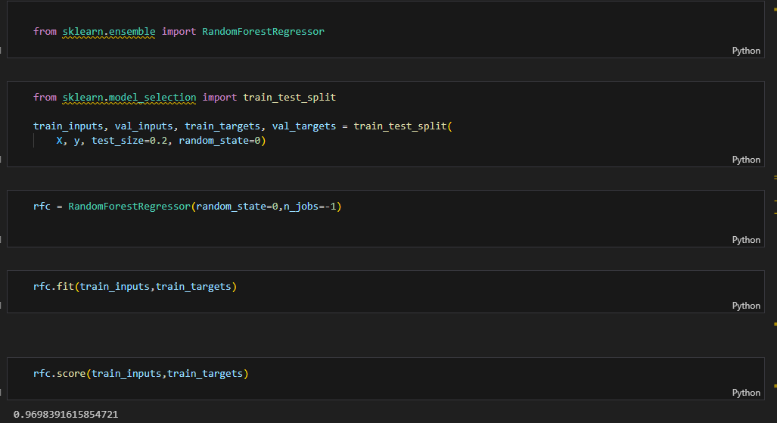
Model Training

Slide 25
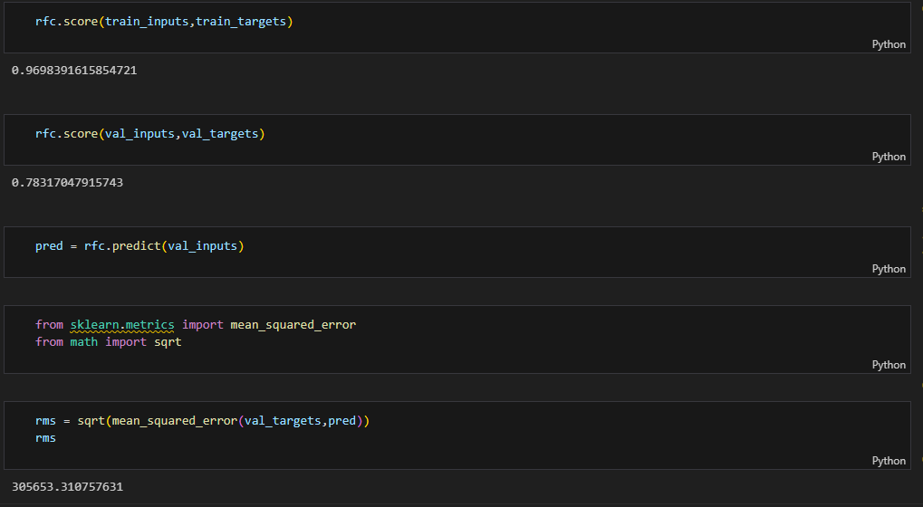

Slide 26
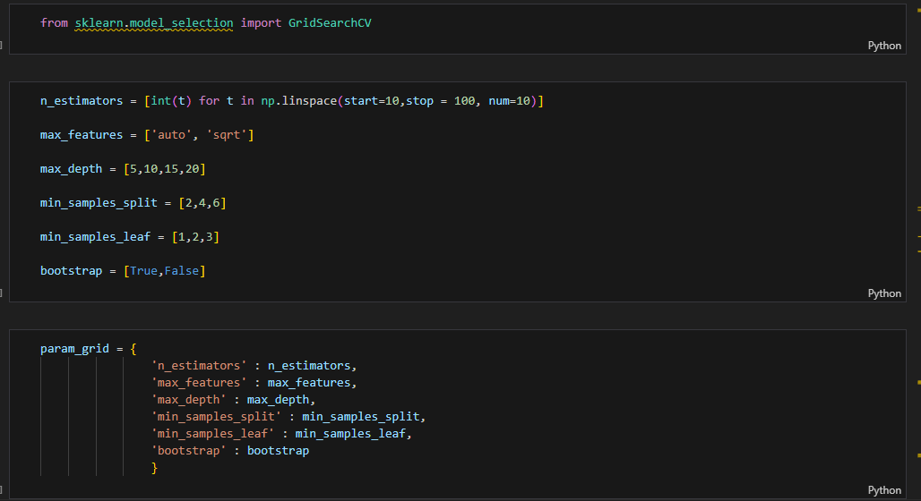
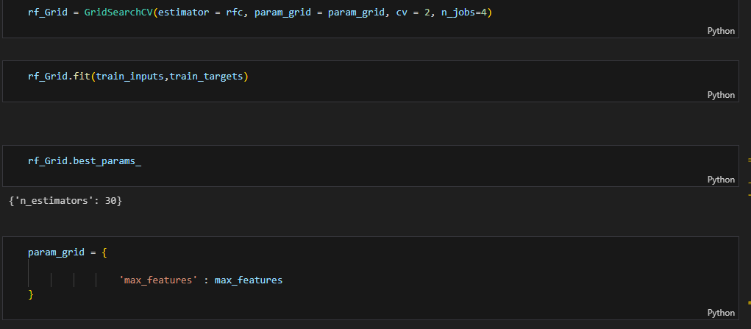

Slide 27
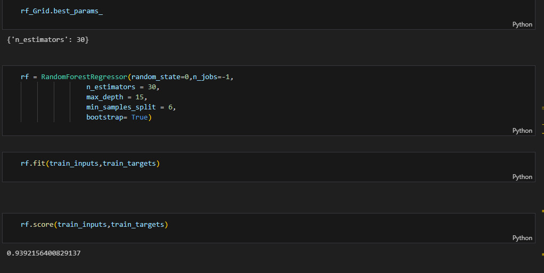

Slide 28
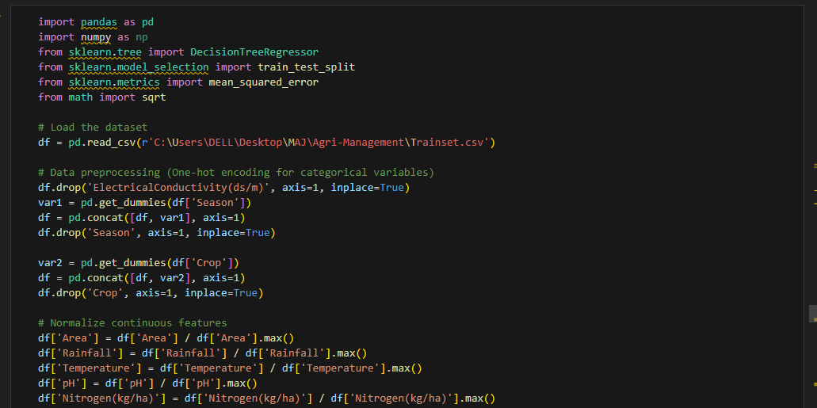
Training

Slide 29
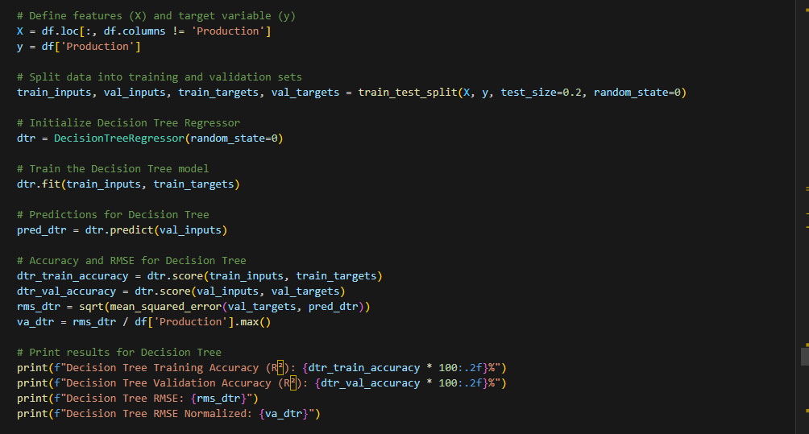

Slide 30
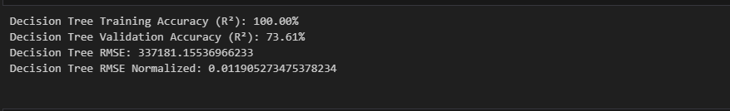
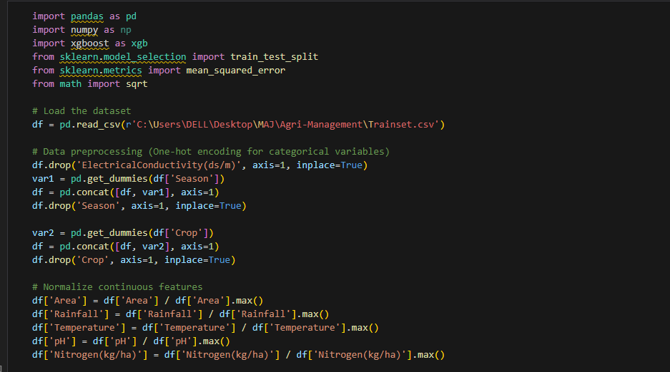

Slide 31
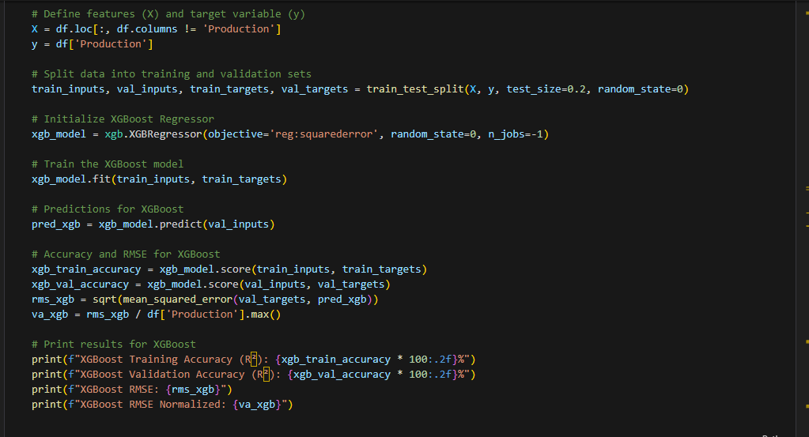
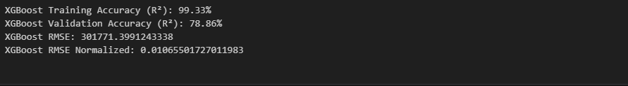

Slide 32
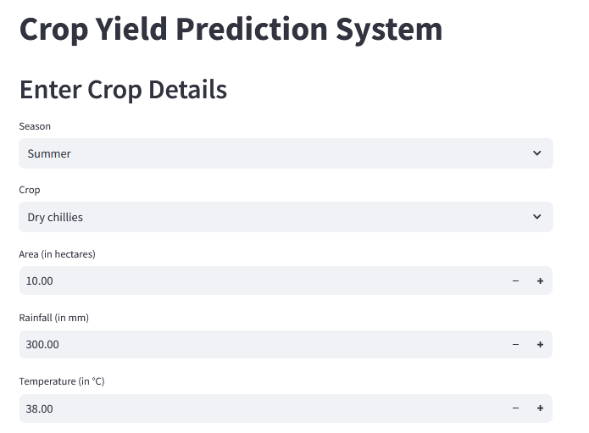
Final Output

Slide 33
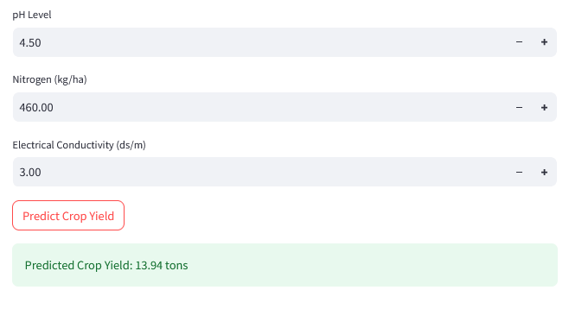

Slide 34
THANK YOU!

